Slide 1

UNLEASHING INSIGHTS FROM THE FOOTBALL DATA USING MULTIPLE TOOLS
CAPSTONE PROJECT
MENTOR : MUNNA PANDEY
SUBMITTED BY :
M.PRIYANKA

Slide 2

OBJECTIVE: This project is to analyze a football dataset to identify key factors for success, specifically within areas such as performance analysis etc. And involved the data preprocessing and merging and performing descriptive analysis etc….
FOCUS AREAS :
Performance Analysis
Player Profile and Market Value
Team Comparison
Attendance and Stadium Analysis
Referee Analysis
Substitution Analysis
Event Analysis
Competition Analysis
Player Attributes and Demographics
Contract Management

Slide 3
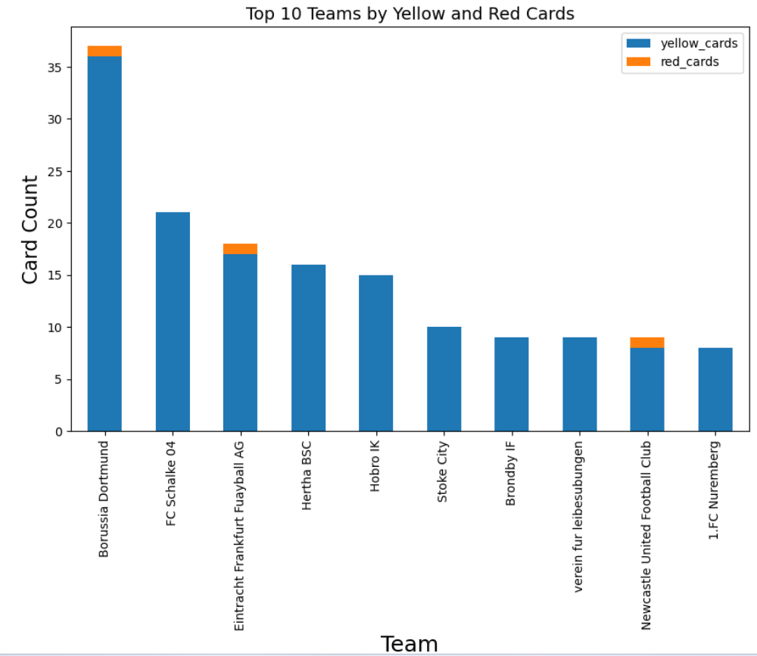
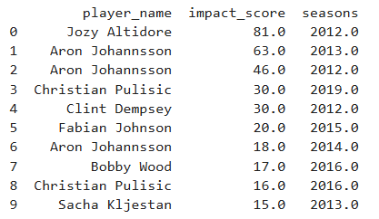
SPRINT-3 : PERFORMANCE ANALYSIS
Evaluate and analyze which player’s performance has
the highest impact on match outcomes based on goals and
assists?
Identify the top 10 teams with the highest number of yellow and red cards in home club?
INTERPRETATION : The player performance will be analysed based on the goals and assists. So identified the top 10 players on outcomes of goals and assists . The Jozy Altidore has the highest performance based on the outcomes of the match and followed by Aron Johnson.
INTERPRETATION: The highest number of yellow cards and red cards were identified in the team of Borussia Dortmund with 36 yellow cards and 1 red card.

Slide 4
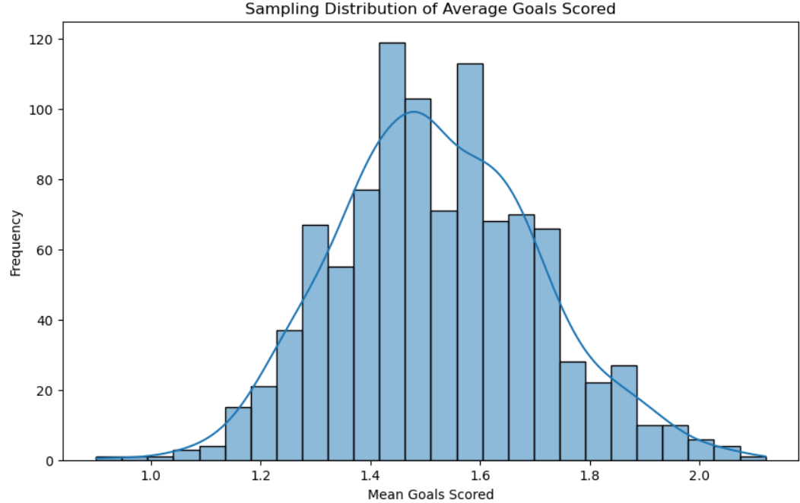
PROBABILITY
JOINT PROBABILITY : What is the probability that a SAMPLING
player scored a goal and received a yellow card in the same
match?
INTERPRETATION: Here the probability that a player scored
a goal and received yellow card in the same match is 0.01 it
means less players have scored a goal and received a yellow card.
CONDITIONAL PROBABILITY: What is the probability
that a player scoring a goal within at least 45 minutes?
INTEERPRETATION: The probability that a player scoring a goal
Within at least 45 minutes is 30 % which is exactly of half of the time
that a player scored goal.
INTERPRETATION :The plot of sample means will approximate a normal distribution and also supporting the central limit theorem.

Slide 5
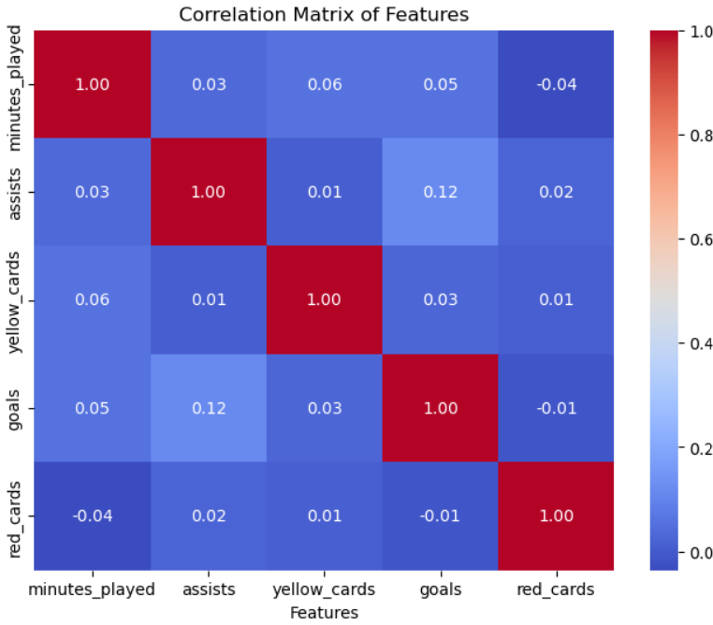
SPRINT 4 →LOGISTIC REGRESSION FOR CLASSIFICATION.
Can we predict if a player will have a high-performance match based on historical data?
Classification : data['high_performance'] = ((data['goals'] >0) & (data['assists']) >0).astype(int)
# Select features
features = ['minutes_played', 'assists', 'yellow_cards','goals','red_cards’]
X = data[features]
y = data['high_performance’]
#OUTPUT:
Accuracy:0.98
Recall:0.66 , Precision=0.77
F1-Score=0.70
Confusion Matrix; [[1378 4
10 5]]
INTERPRETATION:
The accuracy of model is 98 %,indicating that model is correctly predicated.
Confusion matrix: The model has high number of true negatives predicting the players where does not have high performance.
Precision: The model predicts the high performance 77%were correct.
Recall: Out of all the players who actually has high performance the model correctly identified 66%

Slide 6
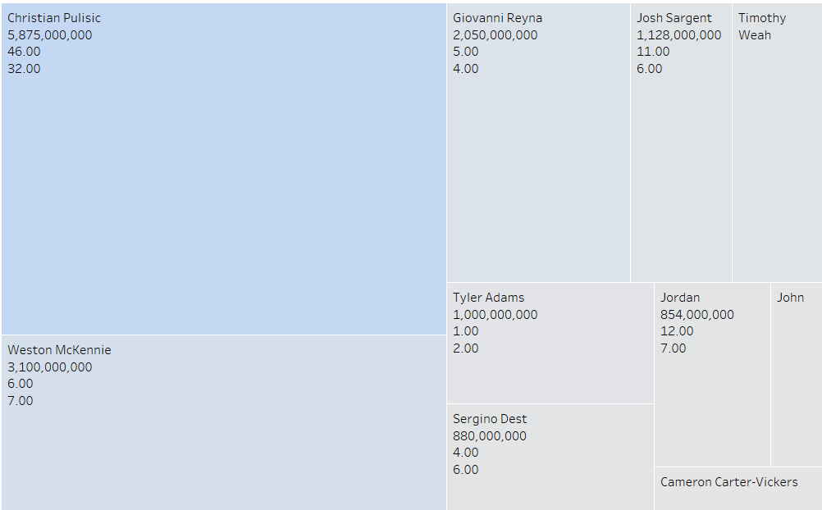
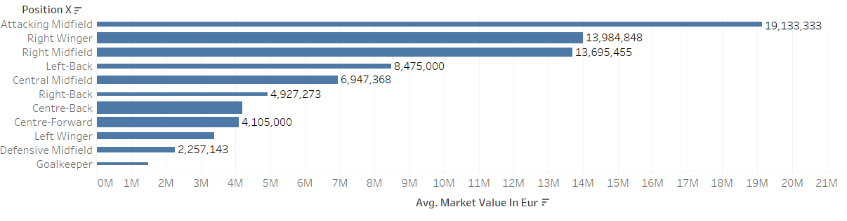
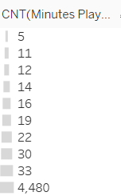
PLAYER PROFILE AND MARKET VALUE
Which players have the highest market value based on
goals and assists in the dataset?
Which position has highest average market value?
INTERPRETATION: The attacking midfield has highest average market value. And followed by right winger.
INTERPRETATION: The Christian pulisic has highest market value with Eur 5,87,000,00 and followed by Weston Mckennie.

Slide 7
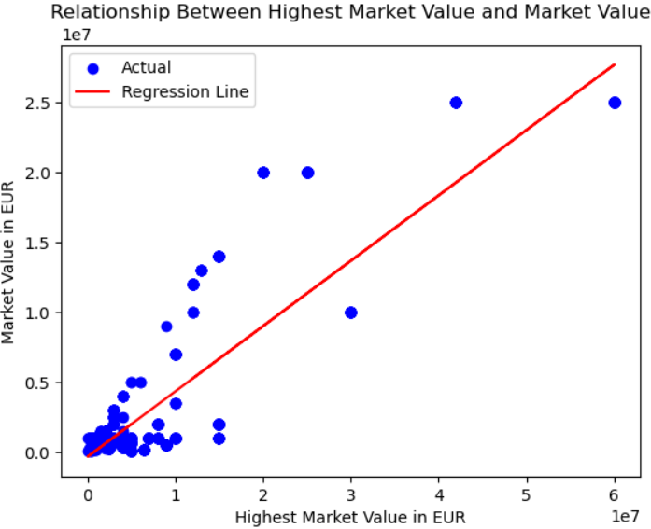
SPRINT5 → SIMPLE LINEAR REGRESSION
HOW DOES THE HIGHEST MARKET VALUE IMPACT THEIR CURRENT MARKET VALUE ?
X= data[['highest_market_value_in_eur’]]
y = data[['market_value_in_eur']]
The R2 score of the model is: 0.7868729406735644
INTERRETATION:
R SCORE : This value indicates that approximately 78% of the variance in the target variable (market value). This model suggesting that has the relationship between the predictors and the market value.
Based on the visual representation, we can interpret that there is a positive relationship between the "Highest Market Value" and the "Current Market Value". As the "Highest Market Value" increases, the "Current Market Value" tends to increase as well

Slide 8
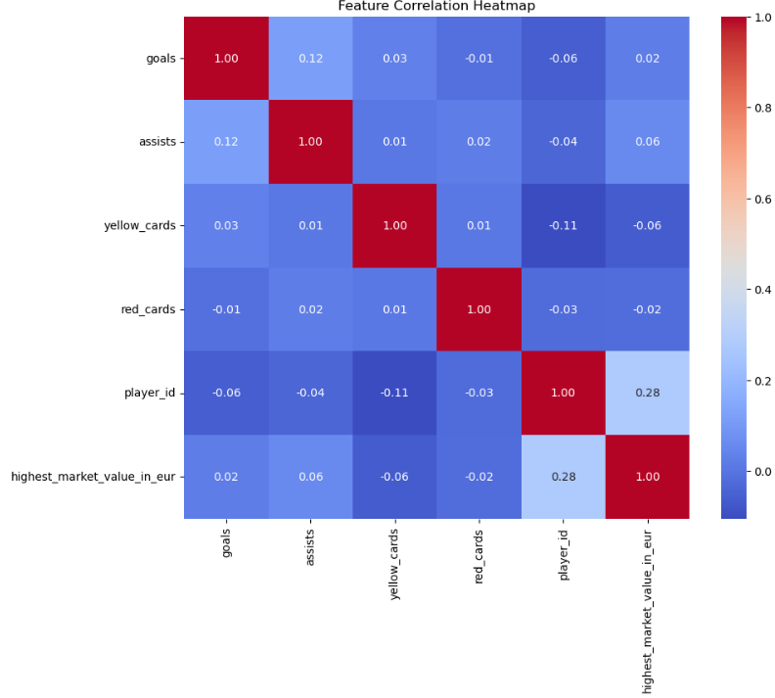
MULTIPLE LINEAR REGRESSION
How can we Predict player’s market value by analyzing key performance metrics such as goals, assists etc..?
features = ['goals','assists','yellow_cards','red_cards’,
'player_id','highest_market_value_in_eur’]
X = data[features]
y = data['market_value_in_eur']
OUTPUT:
R-squared: 0.8543352084411382
Interpretation:
R-squared: 0.8543352084411382 Multiple linear regression: R-squared (0.8443) indicates that approximately 84.43% of the variance in the dependent variable (likely "Current Market Value") can be explained by the independent variables in the model.
This suggests a good of the model to the data.
Goals vs. Assists: Strong correlation (0.12), suggesting players scoring more goals often provide more assists.
.

Slide 9
SPRINT-6 TEAM COMPARISION
Does a player’s foot preference(left/right)
influence their goal-scoring ability?
What is the average market value of players, and how does it vary by position in home club?
Row Labels | Average of market_value_in_eur
Attack | 54,41,515
Defender | 23,69,127
Goalkeeper | 8,37,270
Midfield | 61,32,374
Grand Total | 43,55,189
INTERPRETATION: Yes, the both foot influence most average goals and average assists scored with 0.11 and 0.13 and followed by the right.
INTERPRETATION: The highest average market value of a player is 61,32,374 in the position of Midfield .

Slide 10
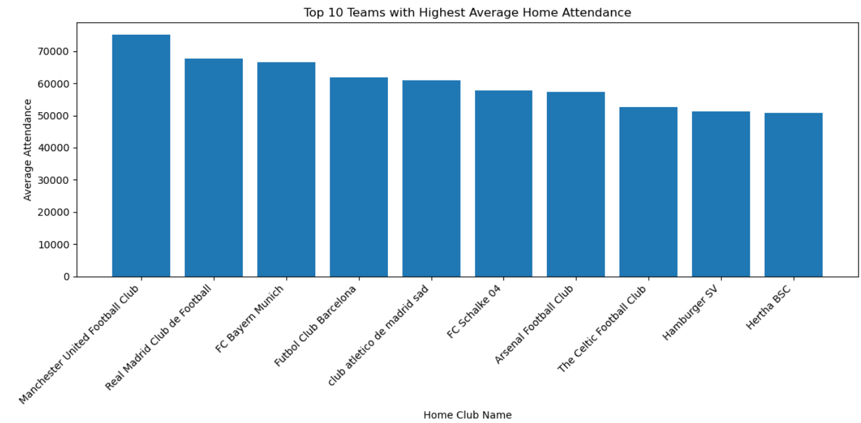
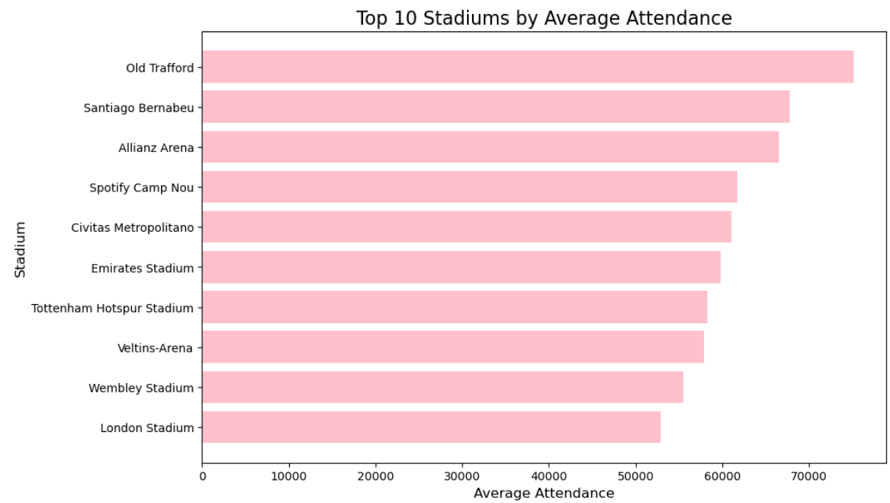
SPRINT 7 → ATTADANCE AND STADIUM ANALYSIS
Which teams attract the highest average attendance at
home club ?
Which stadiums consistently perform better in terms of attendance?
INTERPRETATION: The highest average attendance in home club is Manchester united football club team with the above of 77000 .
INTERPRETATION: The Old Trafford stadium consistently performing better in terms of attendance with the approximately 70000

Slide 11
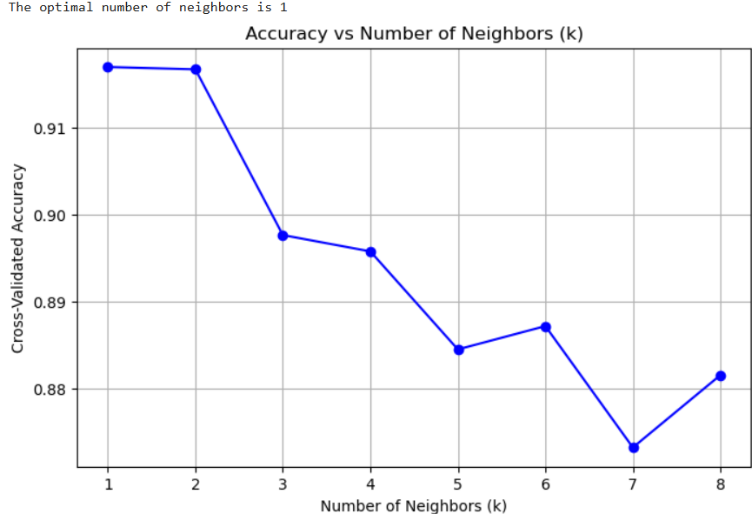
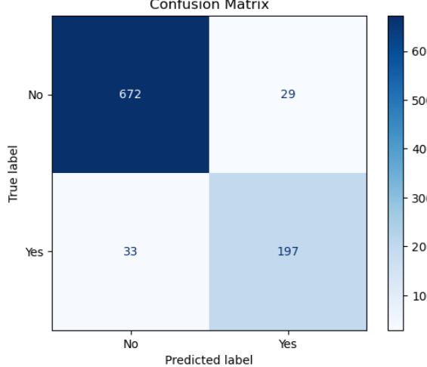
BUSINESS QUESTION RELATED K-NEAREST NEIGHBOUR(KNN) CLASSIFICATION
Can we classify stadiums based on their likelihood of hosting high-attendance matches?
# Create the target variable
data['HighAttendance'] = np.where(data['attendance'] > 40000, 'Yes', 'No')
# Features for prediction
features = ['stadium', 'season', 'home_club_goals', 'away_club_goals’]
X = data[features]
y = data['HighAttendance’]
Interpretation: Accuracy: The accuracy score of 0.933represents a high level of performance.
This means that the KNN classier correctly predicted the class labels for approximately 93% of the instances in the test dataset. Confusion Matrix: True Positives (TP): 672 - The model correctly predicted that 832 players would score a goal.
True Negatives (TN): 197 - The model correctly predicted that 197 players would not score a goal.
False Positives (FP): 29 - The model incorrectly predicted that 29 players would score a goal when they did not.
False Negatives (FN): 33 - The model incorrectly predicted that 33 players would not score a goal when they did.

Slide 12
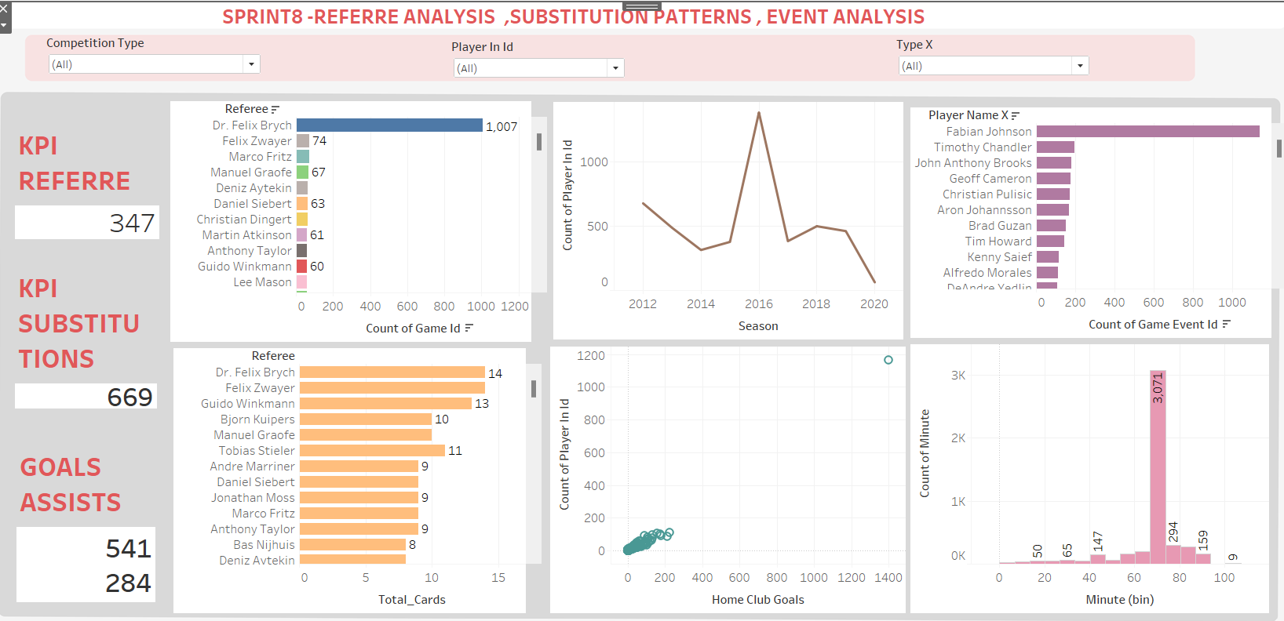
SPRINT 8→ REFERRE ANALYSIS , SUBSTITUTION ANALYSIS , EVENT ANALYSIS
INTERPRETATION : Dr.Felix Brych is issued more yellow cards and red cards and also officiated the more games, And in the year of 2016 the substitutions were more and also Faibian Johnson involved in more key events like goals etc….

Slide 13
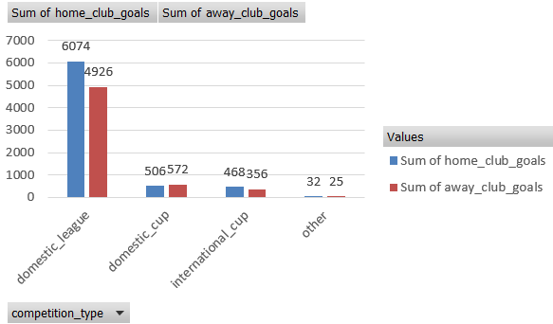
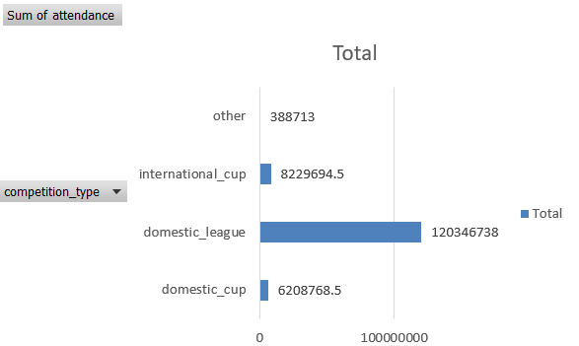
SPRINT 9–> EVENT ANALSYSIS,COMPETETION ANALYSIS
Business question on hypothesis testing.
->Null Hypothesis (H0): Home teams do not score significantly
more goals than away teams.
->Alternative Hypothesis (𝐻𝑎): Home teams score significantly more
goals than away teams
INTERPRETATION:
Which competition type has the highest goals scored in home club and away club?
INTERPRETATION:In the domestic_league type has highest goals scored in home and away club with the 6074 and 4926 goals .
T-Statistic: 10.168129153700171, P-Value: 3.6926276633557134e-24
Reject the null hypothesis: Home teams score significantly more goals
than away teams.
Which competition has the highest average attendance?
INTERPRETATION: The domestic league has highest average attendance.

Slide 14
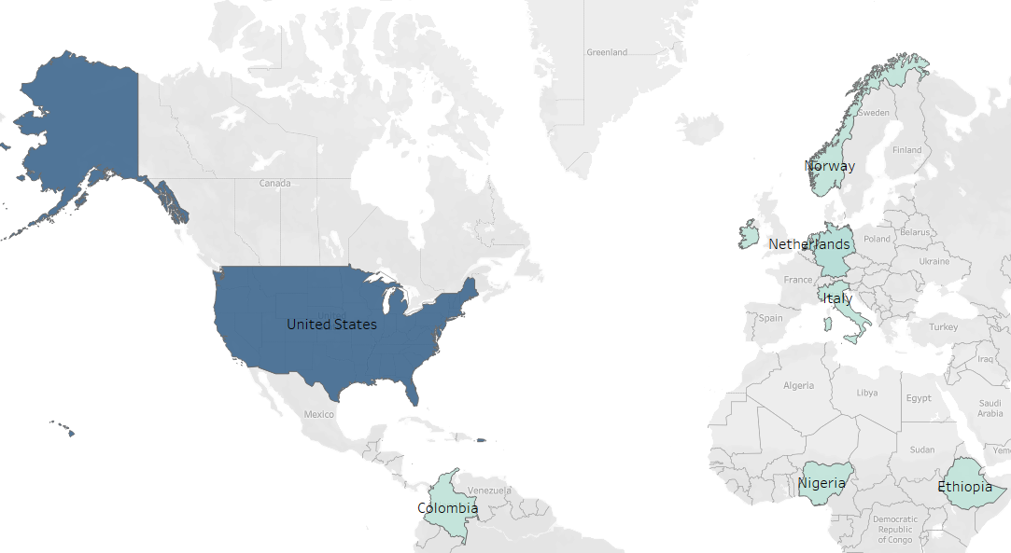
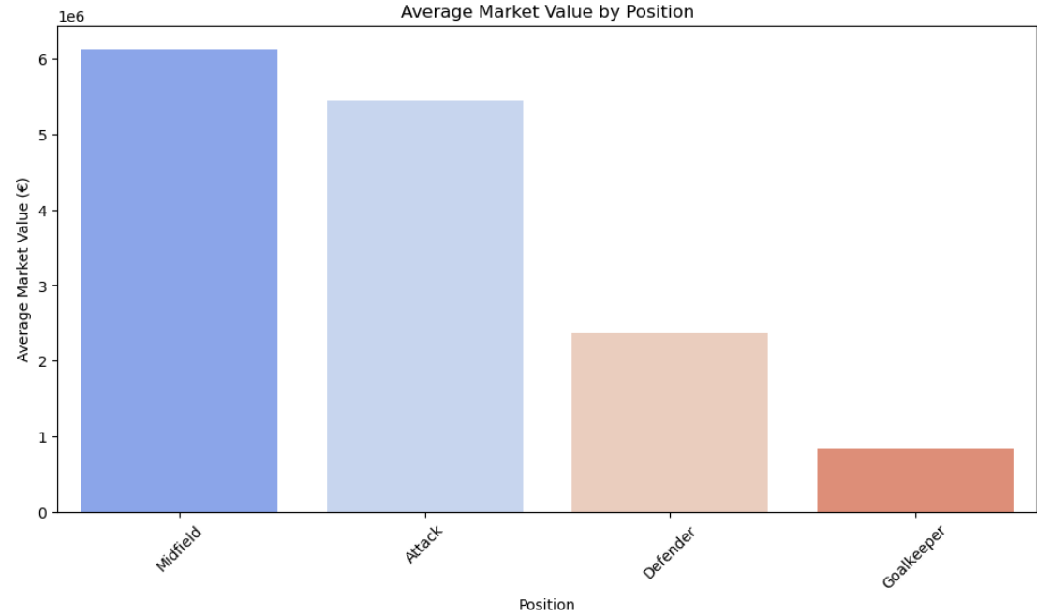
SPRINT10→ PLAYER ATTRIBUTES AND DEMOGRAPHICS
Which countries produce the most valuable players?
How does the player's position impact their market value?
INTERPRETATION: The United States produce most valuable players and has highest market values with the 1.6e+10
INTERPRETATION: The Midfeild has highest market value.

Slide 15
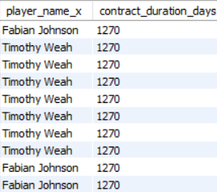
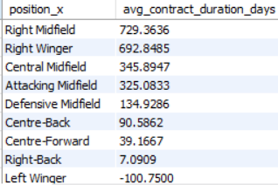
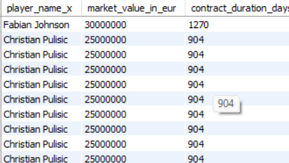
SPRINT10→ BUSINESS OBJECTIVE QUESTION ON CONTRACT MANAGEMENT
Which players have the longest contract durations?
SELECT player_name_x, DATEDIFF(contract_expiration_date,
CURRENT_DATE) AS contract_duration_days
FROM football_data_merged_cleaned
ORDER BY contract_duration_days DESC
LIMIT 10;
Which positions have the highest average contract duration?
SELECT position_x, AVG(DATEDIFF(contract_expiration_date, CURRENT_DATE))
AS avg_contract_duration_days
FROM football_data_merged_cleaned
GROUP BY position_x
ORDER BY avg_contract_duration_days DESC;
How does the player's market value influence the contract duration?
SELECT player_name_x, market_value_in_eur, DATEDIFF
(contract_expiration_date,now()) AS contract_duration_days
FROM football_data_merged_cleaned
ORDER BY market_value_in_eur DESC;
INTERPRETATION:The player Fabian Johnson has longest duration with 1270 days .

Slide 16
CONCLUSION OF PROJECT
Performance Analysis:
Player contribution to team success:
Jozy Altidore has highest goals and assists in 2012
Aron Johnson is second highest impact score in 2013.
Borussia Dortmund team has highest yellow and records with 36 and 1.
Probability:
In joint probability scoring one goal and got tallow card in same match is 0.01
In conditional scoring one goal at least in 45 m is 30 %.
Sampling the average goals are distributed normally.
Player profile and Market value:
The Christian has highest market value based on the goals.
The attacking midfield position has highest average market value and
followed by the Right winger position.
Simple linear regression : In simple linear regression, it has accuracy of 78% and having good relationship between current value and highest market value.
Team Comparison:
Foot preferences: The both foot has highest goals scoring ability in hom e club and away club with 0.11,0.13
Position: The Midfield position has highest average market value with 61 L ad followed by Attack position with the 54 L
Attendance and Stadium Analysis:
The old Trafford stadium has highest average attendance with 70 k and followed by Santiago with approx. 60 K.

Slide 17
Home club: In home club Manchester team attracts high attendance with the 77 K.
Competition Type: The domestic league has highest average stadium attendance with the 43K.
KNN: The accuracy is 93% so it is predicting correctly of high attendance matches.
Referee Analysis:
Dr.Felix Brych is issued more yellow cards and red cards and also officiated the more games, And in the year of 2016.
Substitution Analysis:
The substitutions were more in the year of 2016.
Event Analysis:
Faibian Johnson involved in more key events like goals etc….
Hypothesis Testing : In hypothesis testing the home club score more goals than away club and t statistics is 10.16 and p value is 3.6 so it is going to reject null hypothesis.
Competition Analysis: In the domestic league type has highest goals scored in home and away club with the 6074 and 4926 goals .
The domestic league type has achieved highest attendance.
Player Attributes and Demographics: The United States produce most valuable players and has highest market values with the 1.6e+10.And followed by England with approximately 0.41.6+e
And midfield has highest market value.
Contract Management: Fabian Johnson has longest duration of 1270 days and he has highest average market value.

Slide 18
THANK YOU

